Slide 1

HOTSPOT WEBSITE
GROUP 32:
Mohamad Karbejha - 20180301125
Imad AL-Khawam -20190301539
Marwan El sabie - 20180301093

Slide 2
Project Purpose And Targets
The purpose of this project is to build an interactive media streaming website where users can watch and download different media content.
with the targets:
Faster And Alternative Way To Stream Media Online
More Convenient experience For The User.
More secure to keep the personal data of user in safe place

Slide 3
List of Functions
User’s Control Panel
Sorting And Search Functions
Streaming media content
Admin Control Panel
Downloading content

Slide 4
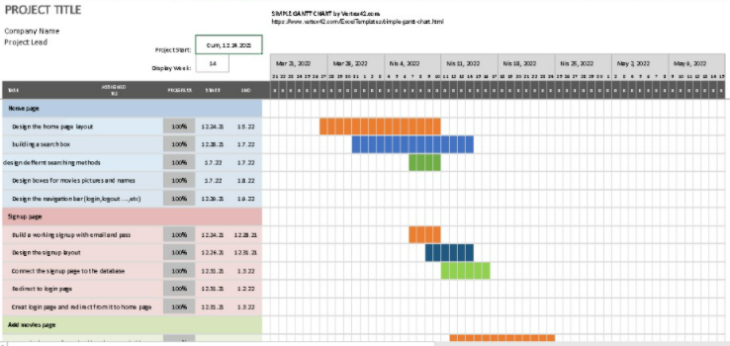
Gantt Chart:

Slide 5
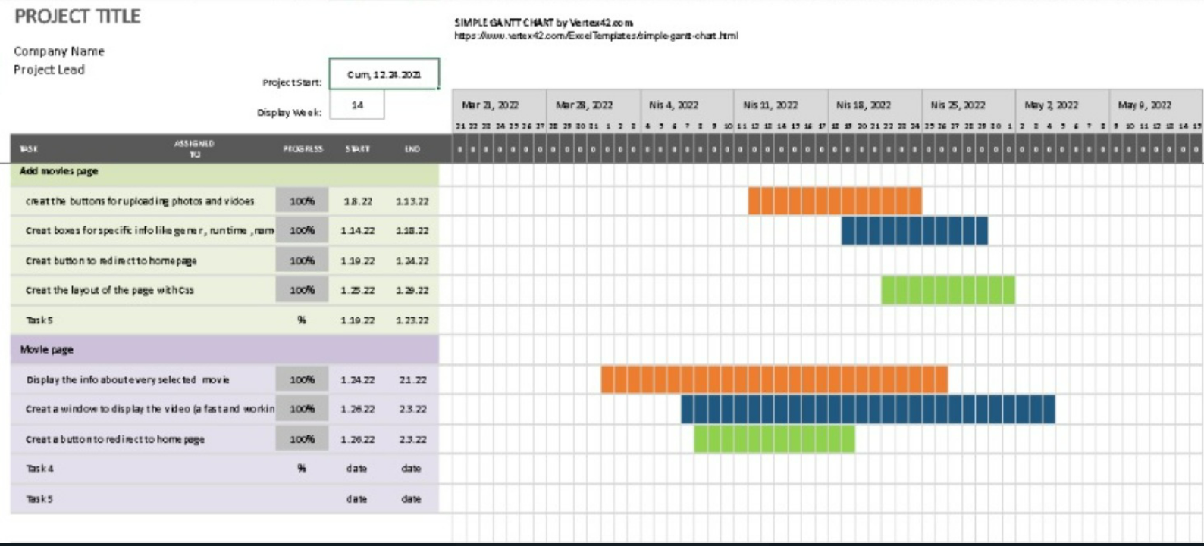
Gantt Chart:

Slide 6
ADVISOR MEETING TABLE
MEETING SUBJECT | ADVISOR NAME | DATE
Requirement Specification Meeting | Birsen Gulden Ozdemir | 11/19/2021
Code Review Meeting | Birsen Gulden Ozdemir | 1/19/2022
Progress meeting | Birsen Gulden Ozdemir | 2/6/2022

Slide 7
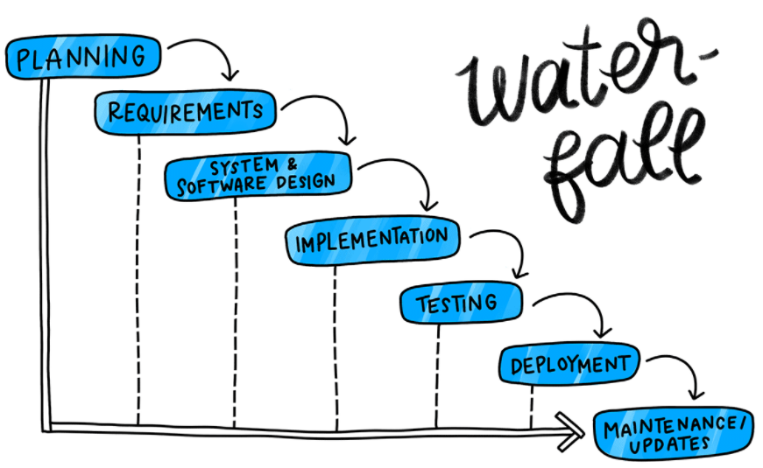
Its one of the oldest and most traditional models for building software's.
Waterfall development process
Working on tasks requires finishing each one sequentially before moving on. However, in most practical applications the phases overlap slightly, with feedback and information being passed between them

Slide 8
sign up
log in
User
homepage
Admin page
Admin
Uml Use Case Diagram
Movie page
modify media page
Stream
download

Slide 9

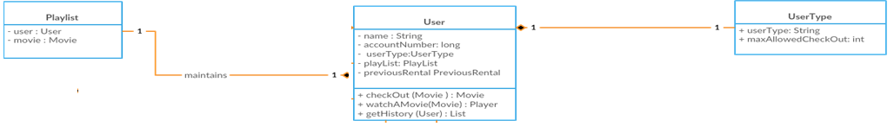
Uml Class Diagram : Before Implementation

Slide 10
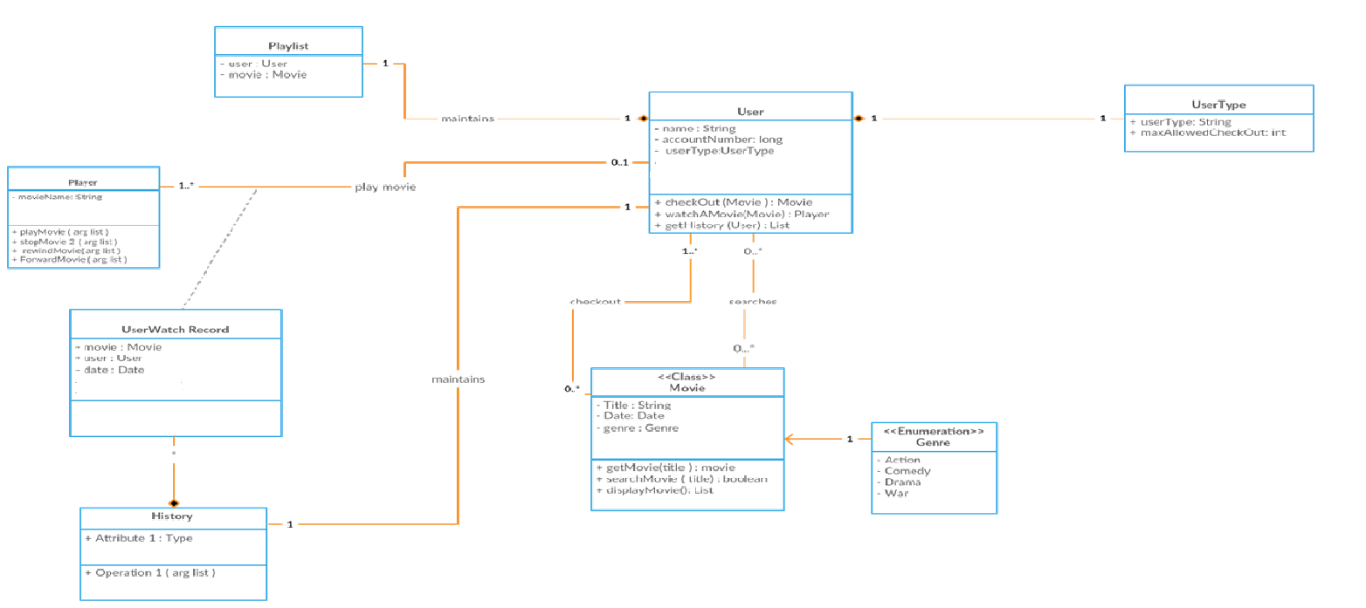
Uml Use Class Diagram : After Implementation

Slide 11
Flow chart diagram: after implementation
Sign in Page
Manual input
Manual input
User enter email and password
Invalid username/password
admin enter email and password
Correct information?
No
TITLE
length
Year
Yes
ID
Successful login
Access to admin control page
DESCRIPTION
Home Page
Access To User Section
movie
URL

Slide 12
The database check
We created A database.
in the prototype version we will have the passwords.
website checks with some php code to see if the entered data matches the ones in the database
Finally performs the request using local XAMP server

Slide 13
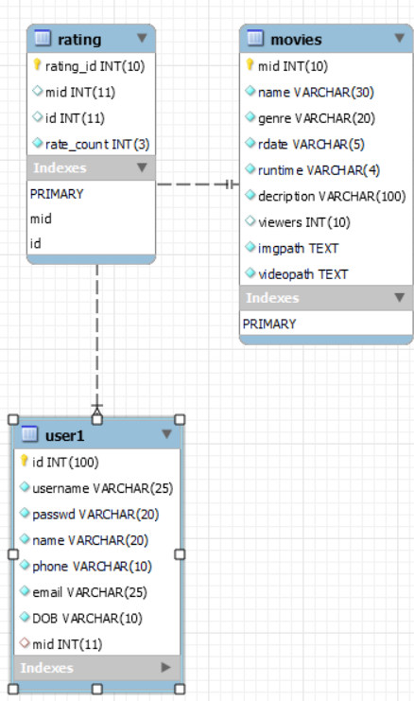
ER DIAGRAM

Slide 14

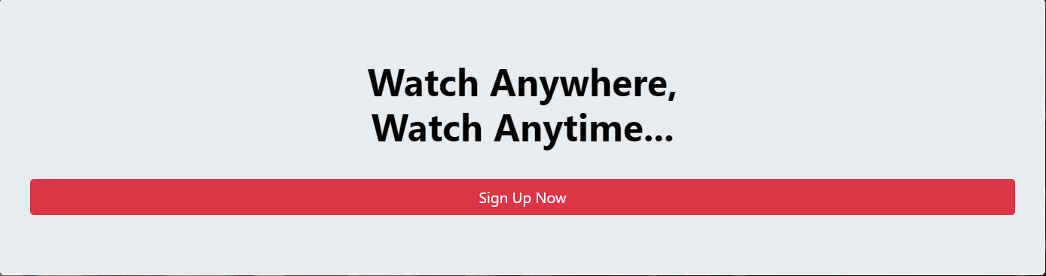
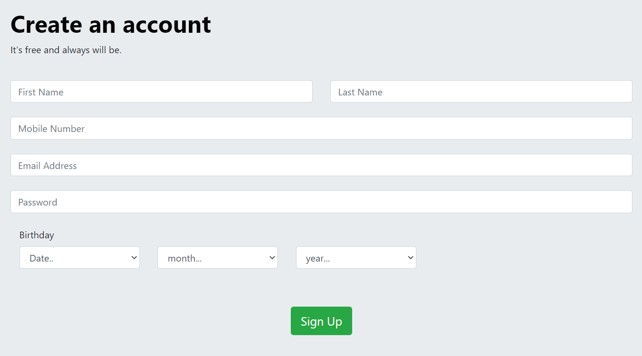
THE SIGN-UP PAGE :
The website simply starts with the sign up page, where you're required to enter your data to register it in the database
The user will be asked to enter a Name , mobile number , email address and a password , and a birthdate
Information should be unique and not repeated or else the user wont be able to sign up

Slide 15
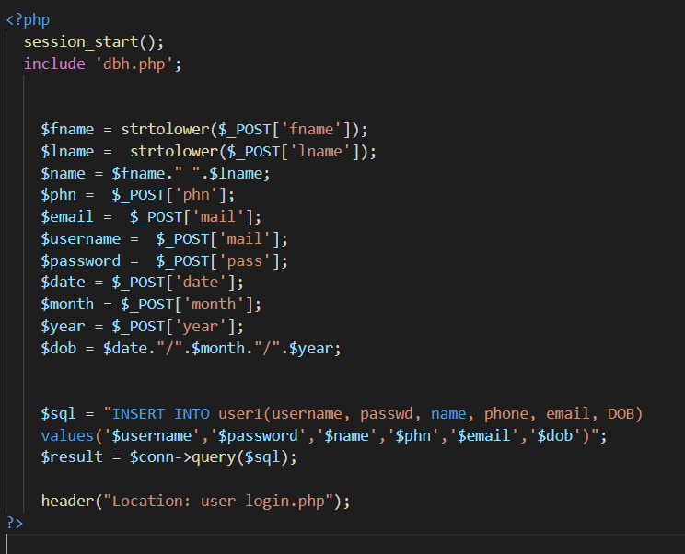
The Sign-Up Page Code:
Using php and MySQL the code will take the user information and store it in the database for future log ins

Slide 16
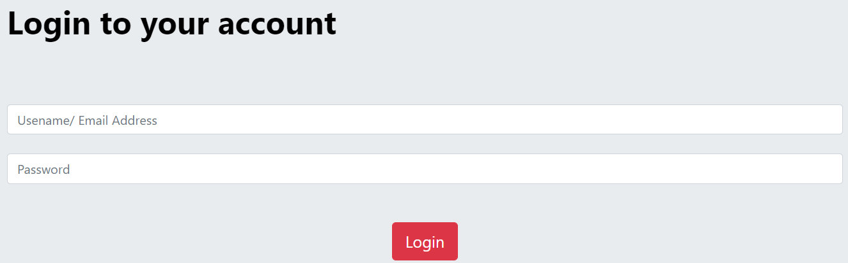
The Login Page :
After signing up the user will be directed to the login page where he will enter his information, and if the login is successful the user will be directed to the homepage
IF the information is incorrect the user will be asked to enter valid credentials in order to access the website

Slide 17
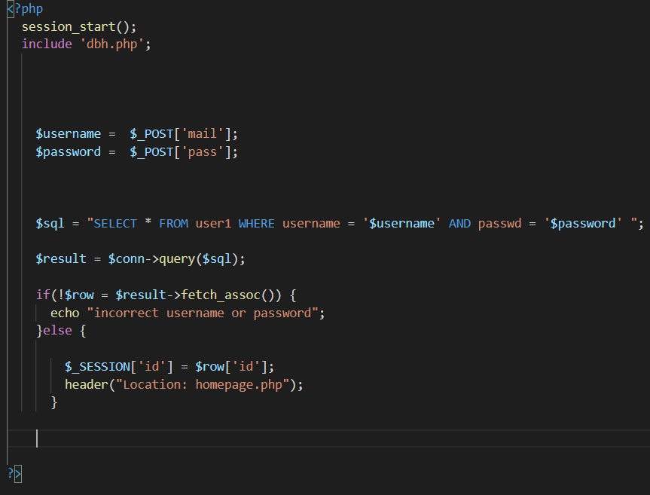
The Login Page Code:
Using php and MySQL data base the code will check the user credentials and decide if its correct or not

Slide 18
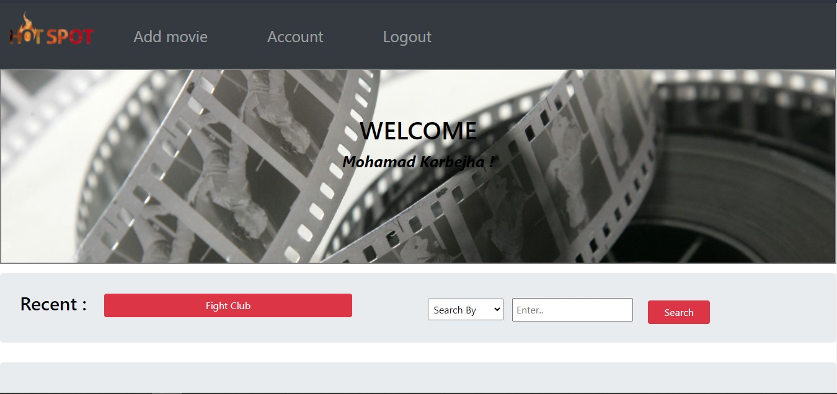
User Interface Design :

Slide 19
